Slide 1
IOT, ITS THREATS, and SOLUTION
Submitted by: Pankaj Bhatt

Slide 2
TABLE OF CONTENT
INTRODUCTION
HOW IT WORKS
USES
ADVANTAGES
DISADVANTAGES
THREATS
SOLUTIONS
CONCLUSION

Slide 3
INTRODUCTION
WHAT IS IOT?
A concept in which objects that are used in our daily life are connected with sensors, software, and network connectivity to collect and exchange data and information.

Slide 4

HOW it works
CONNECTIVITY
IOT DEVICES ARE CONNECTED TO INTERNET AND SENSOR TO COLLECT DATA.
INFORMATION IS SHARED VIA CONNECTION, BETWEEN DEVICES

Slide 5
HOW it works
DATA PROCESSING
THE DATA PROCESSED BY THE DEVICE IS IMPORTANT TO MAKE RESULTS.
DATA IS TAKEN VIA SENSORS OR OTHER COMPONENTS

Slide 6

Uses OF IOT
HEALTHCARE
REALTIME MONITORING
ACCESSIBLE AND AFFORDABLE

Slide 7
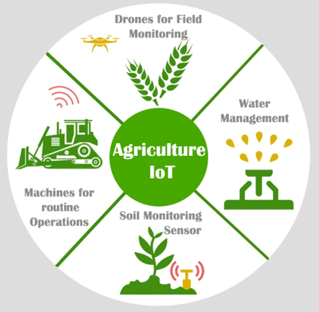
Uses OF IOT
AGRICULTURE
SOIL MONITORING
AUTOMATION IN IRRIGATION
CROP HEALTH ALERTS

Slide 8
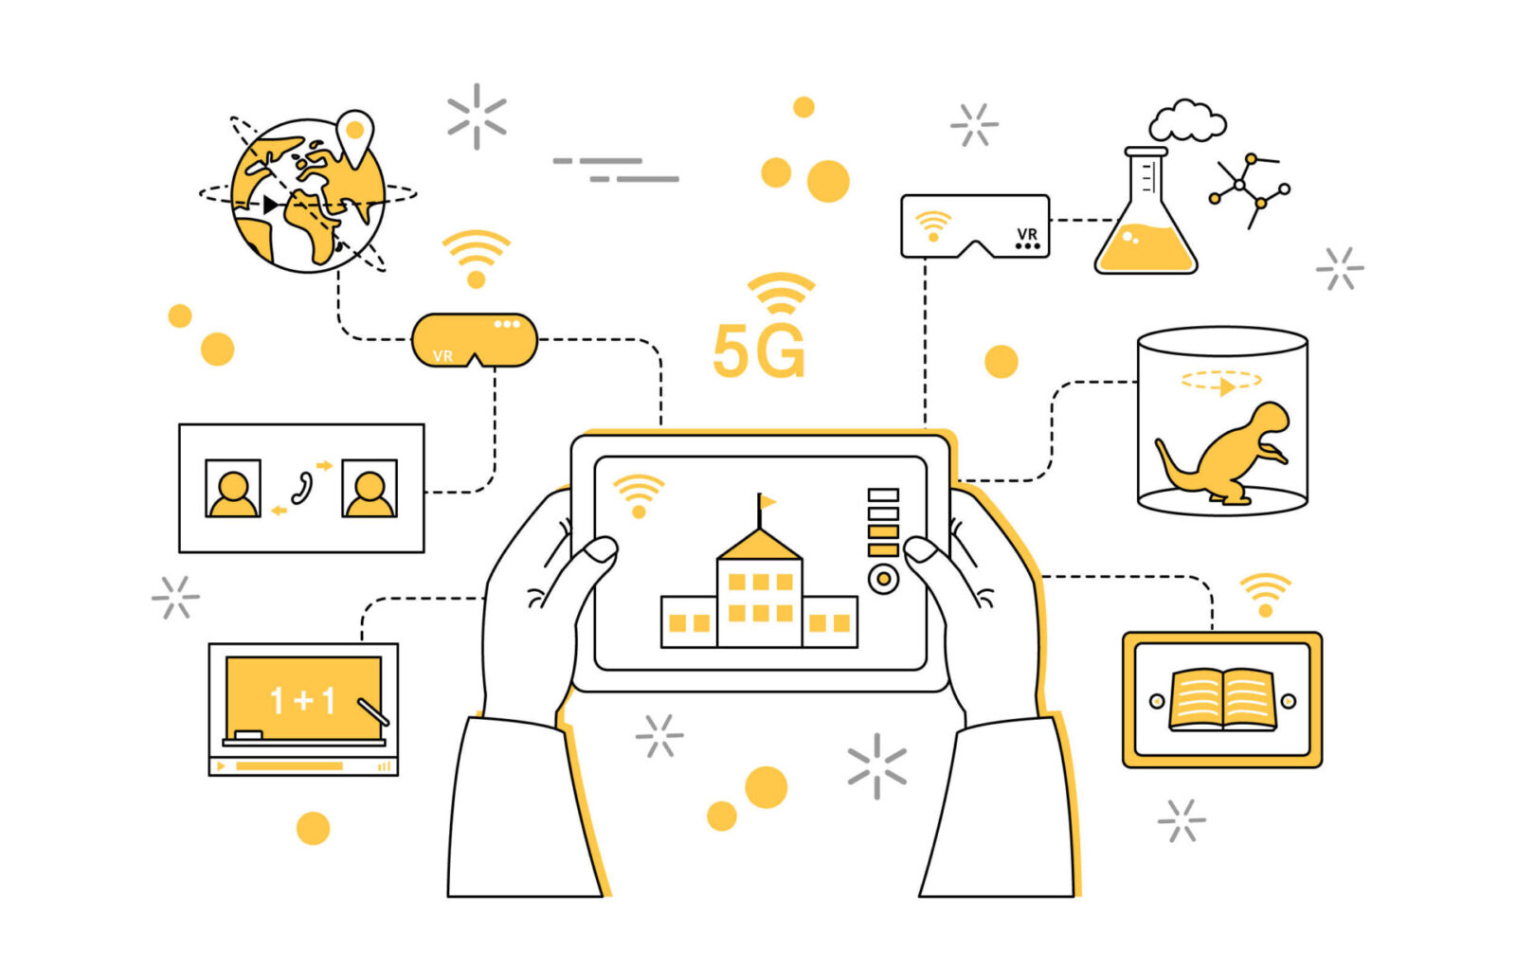
Uses OF IOT
EDUCATION
REMOTE EDUCATION
INTERACTIVE AND QUALITY LEARNING

Slide 9
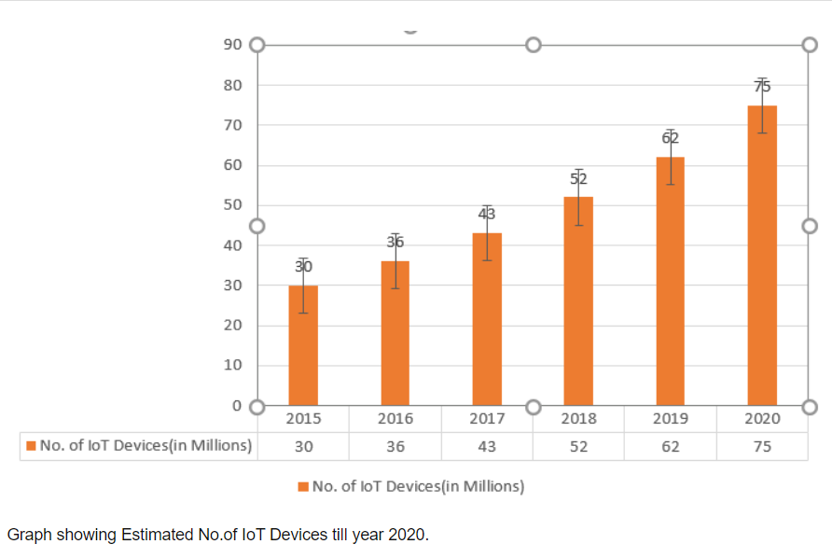
Uses OF IOT

Slide 10
ADVANTAGE
EFFICIENT AND CONVINIENT
AUTOMATIC AND EASY TO USE
TIME SAVING.

Slide 11
ADVANTAGE
COST EFFECTIVE
REALTIME DATA PROCESS
PERSONALIZATION

Slide 12
ADVANTAGE
SUSTAINABILITY
SIMPLIFIED MAINTAINANCE
PERSONALIZATION

Slide 13
DISADVANTAGE
ENERGY CONSUMPTION
LOW CONNECTIVITY
TECHNICAL COMPLEXILITY
​

Slide 14
THREATS
MALICIOUS APPLICATION
PHYSICAL TAMPERING
DATA INTERCEPTION

Slide 15
THREATS
MANUPLATION
RANSOMWARE ATTACKS
PHYSICAL THEFT OF DEVICE

Slide 16
SOLUTIONS
USE OF SECURE FIRMWARE
USE OF FIRE WALL & INTRUSION DETECTION SOFTWARE (IDS)

Slide 17
SOLUTIONS
SECURE DATA TRANSMISSION
IMPLEMENTING THREAT INTELLIGENCE

Slide 18
SOLUTIONS
STRONG PASSWORD FOR ACCESS CONTROL
SECURE LOCATION FOR DEVICE OPERATION

Slide 19
CONCLUSION
In conclusion, the whole future of IOT depends upon the developers, manufacturers and users. The security for the IOT device is the main concern, so the developers and users so focus on investing more on security of IOT device and keep themself aware about ongoing cyber threats.

Slide 20
Thank you for your time
Submitted by: Pankaj Bhatt

